Slide 1
Cholesky Decomposition
Anders Arnold
Varun Singh
Gourab Sarkar
Nikita Jetwani

Slide 2
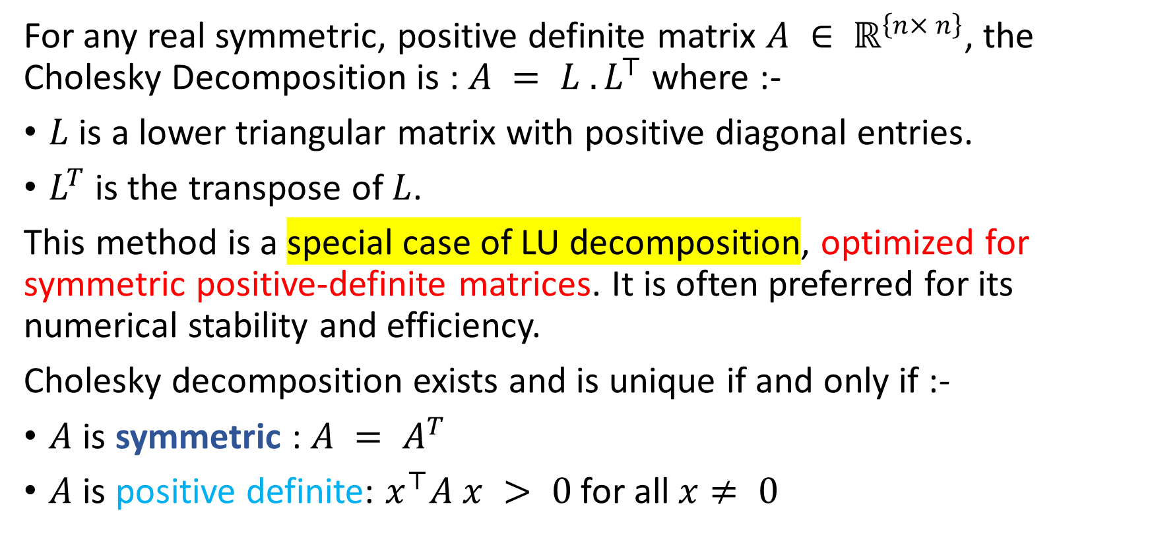
What is Cholesky Decomposition ?
For any real symmetric, positive definite matrix $A ∈ ℝ^{\left\{n× n\right\}}$, the Cholesky Decomposition is : $A = L {. L}^{⊤}$where :-
$L$ is a lower triangular matrix with positive diagonal entries.
$L^{T}$is the transpose of $L$.
This method is a special case of LU decomposition, optimized for symmetric positive-definite matrices. It is often preferred for its numerical stability and efficiency.
Cholesky decomposition exists and is unique if and only if :-
$A$ is symmetric : $A = A^{T}$
$A$ is positive definite: $x^{⊤}A x > 0$for all$x≠ 0$

Slide 3
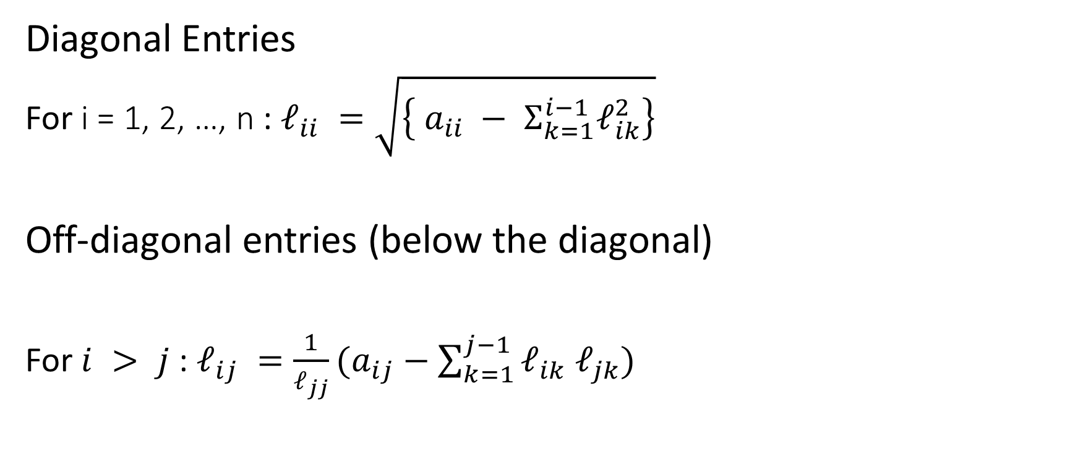
Entry-Wise Formula
Diagonal Entries
For i = 1, 2, …, n : $ℓ_{ii} =\sqrt{\left\{ a_{ii} − Σ_{k=1}^{i−1}ℓ_{ik}^{2}\right\}}$
Off-diagonal entries (below the diagonal)
For $i > j$ : $ℓ_{ij} =\frac{1}{ℓ_{jj}}(a_{ij}−\sum_{k=1}^{j−1}{ℓ_{ik} ℓ_{jk}})$

Slide 4
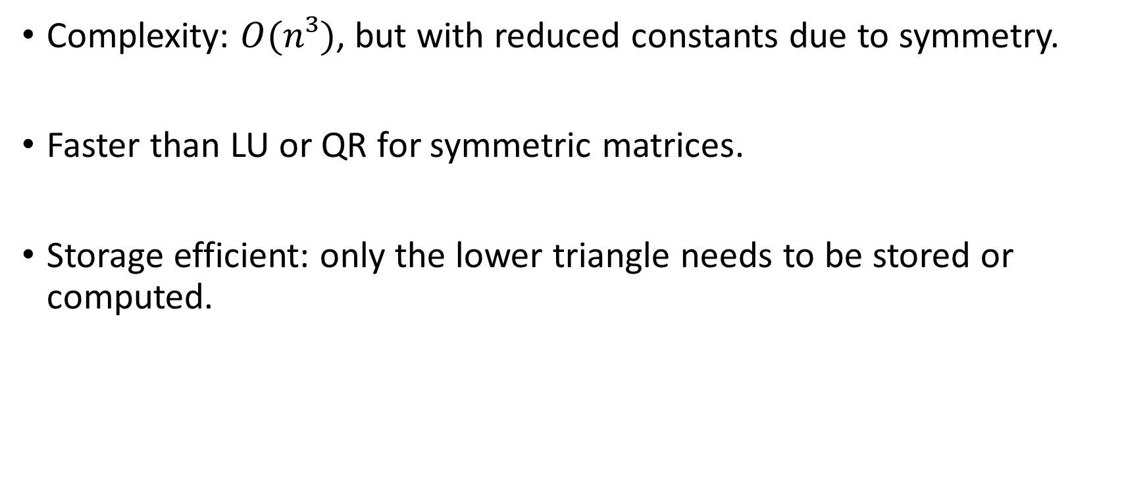
Computational Aspects
Complexity: $O(n³)$, but with reduced constants due to symmetry.
Faster than LU or QR for symmetric matrices.
Storage efficient: only the lower triangle needs to be stored or computed.

Slide 5
Applications in Quantitative Finance
Portfolio optimization : Used in inverting large covariance matrices to find the optimal asset weights in mean-variance optimization.
Monte Carlo simulation : Simulating correlated asset paths using Cholesky decomposition of the covariance matrix.

